Slide 1
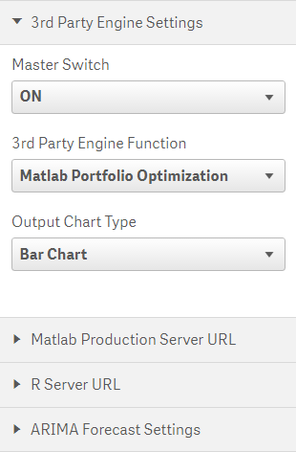
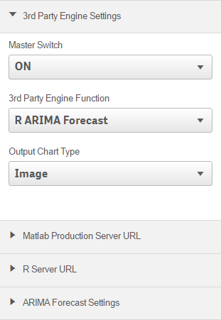
Browser
Qlik Sense
App
Matlab Production Server (MPS)
Extension
6
Other Functions
3
1
4
2
5
Qlik Sense Server
Portfolio Optimization Function
ARIMA Forecast Function
2
1
5
Browser
4
Qlik Sense
App
R Server
Extension
6
Other Functions
3

